Slide 1
Able to develop the real time scenarios based on NodeJS applications.
()
Notes:
Title - The learning outcome
Subtitle - Duration

Slide 2
In this section, we will discuss:
Introduction to mean stack
Introduction to Angular JS and UI benefits in Angular JS
Usage of Angular JS with HTML
Event Handling in Angular JS
Introduction Angular & difference b/w angular-1 to angular-5
Notes:
Mention the parent topics one by one. This particular learning outcome has 5 parent topics.

Slide 3
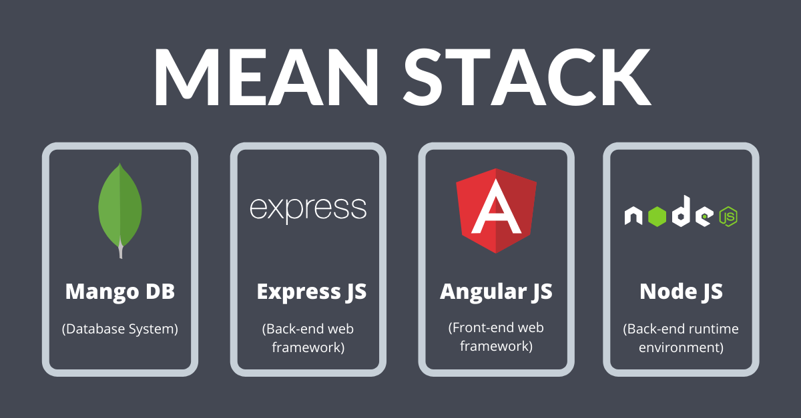
Introduction to mean stack
MEAN Stack
The MEAN stack is JavaScript-based framework for developing web applications
MEAN is comprised of four different technologies:
MongoDB
Express JS
AngularJS
Node.js
Image Source: https://www.thirdrocktechkno.com/blog/what-is-mean-stack-mean-stack-components-and-benefits/
Notes:
Left (White Color space):
Title - Parent Topic
Subtitle - Subtopic 1
Body Text - Description in bullets
Right (Grey Color Space):
Body Text - Relevant image (with source)/code snippet
Mean Stack refers to a collection of JavaScript technologies used to develop web applications. Therefore, from the client to the server and from server to database, everything is based on JavaScript. MEAN is a full-stack development toolkit used to develop a fast and robust web applications.
MEAN is a user-friendly stack which is the ideal solution for building dynamic websites and applications. This free and open-source stack offers a quick and organized method for creating rapid prototypes for web-based applications.
MEAN is comprised of four different technologies:
MongoDB express is a schemaless NoSQL database system
Express JS is a framework used to build web applications in Node
AngularJS is a JavaScript framework developed by Google
Node.js is a server-side JavaScript execution environment
Reference:
https://www.thirdrocktechkno.com/blog/what-is-mean-stack-mean-stack-components-and-benefits/

Slide 4
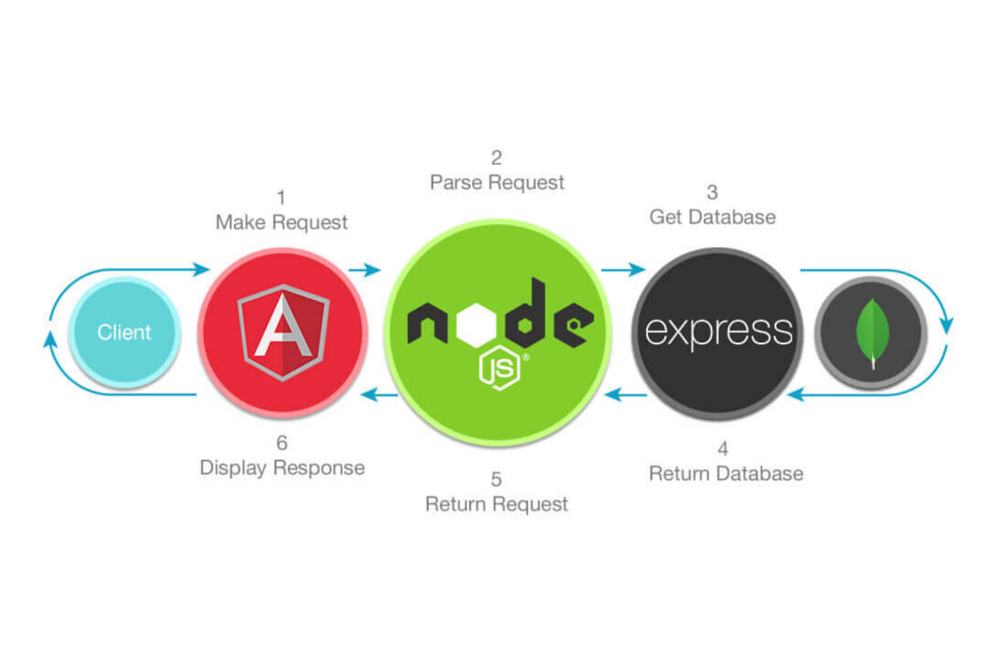
Introduction to mean stack
How Does the MEAN Stack Work?
Angular JS: Accept requests and display results to end user
NodeJS: Handle Client and Server Requests
Express JS: Make requests to Database and return a response
MongoDB: Store and retrieve data.
Image Source: https://www.thirdrocktechkno.com/blog/what-is-mean-stack-mean-stack-components-and-benefits/
Notes:
This slide talks about the case if we have to divide a subtopic further.
Left (White Color space):
Title - Parent Topic
Subtitle - Subtopic
Body Text - Description in bullets
Right (Grey Color Space):
Body Text - Relevant image (with source)/code snippet
AngularJS is a client-side language written in JavaScript. So, firstly the client request is processed by it.
After that, the request enters the server (Node.js), i.e., phase 2. Node.js is a server-side language written in JavaScript.
After that, ExpressJS makes the request to the database, and it is treated as phase 3.
After getting a request, MongoDB retrieves the data & returns the response back to the ExpressJS.
A response is sent back to the Node.js from Express.js, and then it is forwarded to the AngularJS by Node.js for displaying the result.
Reference:
https://www.thirdrocktechkno.com/blog/what-is-mean-stack-mean-stack-components-and-benefits/

Slide 5
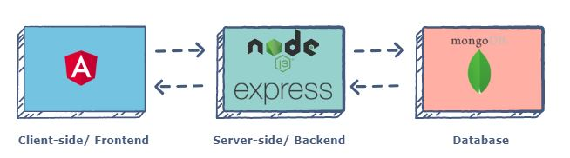
Introduction to mean stack
MEAN Stack Components
MEAN stack architecture supports the MVC.
The MEAN components are free and open-source.
It is flexible to understand and easy to use.
It helps the developers to customize as per the requirement.
Image Source: https://www.educative.io/edpresso/what-is-mean-stack
Notes:
Left (White Color space):
Title - Parent Topic
Subtitle - Subtopic 1
Body Text - Description in bullets
Right (Grey Color Space):
Body Text - Relevant image (with source)/code snippet
Angular.js Front End
At the very top of the MEAN stack is Angular.js, the self-styled “A JavaScript MVW Framework” (MVW stands for “Model View and Whatever”).
Angular.js allows you to extend your HTML tags with metadata in order to create dynamic, interactive web experiences much more powerfully than, say, building them yourself with static HTML and JavaScript (or jQuery).
Angular has all of the bells and whistles you’d expect from a front-end JavaScript framework, including form validation, localization, and communication with your back-end service.
Express.js and Node.js Server Tier
The next level down is Express.js, running on a Node.js server. Express.js calls itself a “fast, unopinionated, minimalist web framework for Node.js,” and that is indeed exactly what it is.
Express.js has powerful models for URL routing (matching an incoming URL with a server function), and handling HTTP requests and responses. By making XML HTTP requests (XHRs),r GETs, or POSTs from your Angular.js front end, you can connect to Express.js functions that power your application.
Those functions in turn use MongoDB’s Node.js drivers, either via callbacks or using Promises, to access and update data in your MongoDB database.
MongoDB Database Tier
MongoDB is a NoSQL database system. It is a cross-platform, documented oriented database which works on the concepts and the documents. It saves data in a binary format generally using JSON format which makes it easier to pass data between the client and the server.
If your application stores any data (user profiles, content, comments, uploads, events, etc.), then you’re going to want a database that’s just as easy to work with as Angular, Express, and Node.
That’s where MongoDB comes in: JSON documents created in your Angular.js front end can be sent to the Express.js server, where they can be processed and (assuming they’re valid) stored directly in MongoDB for later retrieval.
Again, if you want to easily get the best of MongoDB, you’ll want to look at MongoDB Atlas.
Reference:
https://www.educative.io/edpresso/what-is-mean-stack

Slide 6
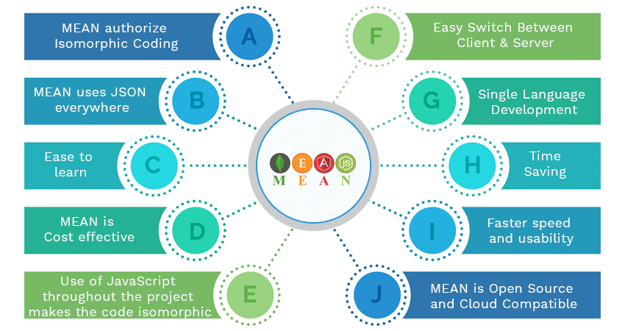
Introduction to mean stack
Benefits of using Mean Stack
MEAN makes the switching between client and server easier
Isomorphic Coding is possible with MEAN
Highly Flexible
MEAN uses JSON
Cost effective
High Speed and Reusability
Open Source and Cloud Compatible
Image Source : https://www.amarinfotech.com/wp-content/uploads/2018/05/Mean-Stack-App-Development-Advantages.png
Notes:
Left (White Color space):
Title - Parent Topic
Subtitle - Subtopic
Body Text - Description in bullets
Right (Grey Color Space):
Body Text - Relevant image (with source)/code snippet
Benefits
Allows creating a simple open source solution and build robust and maintainable solutions..
Helps in development of applications on rapid base.
MEAN is full stack JavaScript which is 100% free.
Only single uniform language throughout your stack development.
Uses very low memory footprint/overhead.
Helps you to avoid unnecessary groundwork.
Application is kept organized.
MongoDB is built for the cloud.
js simplifies the server layer.
MEAN makes code isomorphic.
Reference:
https://www.amarinfotech.com/wp-content/uploads/2018/05/Mean-Stack-App-Development-Advantages.png

Slide 7
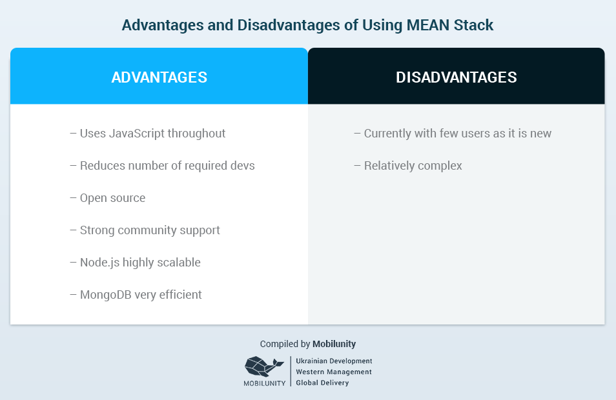
Introduction to mean stack
Disadvantages of Mean Stack
Not recommended for large-scale applications.
No specific general JS coding guidelines.
It offers poor isolation of server from business logic.
You could lose records gradually.
Image Source:https://brainleaf.com/blog/development/javascript-mean-stack-development/
Notes:
Left (White Color space):
Title - Parent Topic
Subtitle - Subtopic
Body Text - Description in bullets
Right (Grey Color Space):
Body Text - Relevant image (with source)/code snippet
Disadvantages
You could potentially lose records
The claim is that MongoDB is strongly consistent, but sometimes, this could change. When network partitioning occurs, especially in heavy load scenarios, there is a chance that you could lose records that has been successfully written by MongoDB.
This doesn’t have to happen all the time, but chances are present.
Poor isolation of server from business logic
Express.js has poor isolation of server from business logic and this prevents the reuse of certain services like batching operations. You have to go through the Express middle chain for internal jobs, and this could be bothersome.
Can’t beat the power of relational databases yet
MEAN stack, when compared to relational databases doesn’t provide the same level of functionality. Relational databases is till the first choice for many big names like Google and Facebook, as it is more reliable and stable.
Reference:
https://brainleaf.com/blog/development/javascript-mean-stack-development/

Slide 8
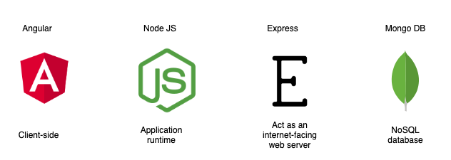
Introduction to mean stack
How secure is the MEAN stack?
Always use HTTPS
Preventing XSS & Request Forgery
Preventing SQL Injections
Security in Web API authentication
Image Source: https://miro.medium.com/max/1264/1*XywIcbNgkWiedwsXBKsDQA.pn
g
Notes:
Left (White Color space):
Title - Parent Topic
Subtitle - Subtopic
Body Text - Description in bullets
Right (Grey Color Space):
Body Text - Relevant image (with source)/code snippet
We have a team of developers who highly recommend using Mean Stack with MongoDB Atlas. As Atlas comes with built-in credentials and end-to-end encryptions, it's the best foundation for securing MongoDB. Additionally, Mean Stack comes with concrete three-tier separation using best practices and correct network isolation. There are times when it prevents end-users from accessing the business logic and database layer. The application designed using this tool is the default to avoid malicious user interaction from putting your application at risk.
Reference:
https://miro.medium.com/max/1264/1*XywIcbNgkWiedwsXBKsDQA.pn

Slide 9
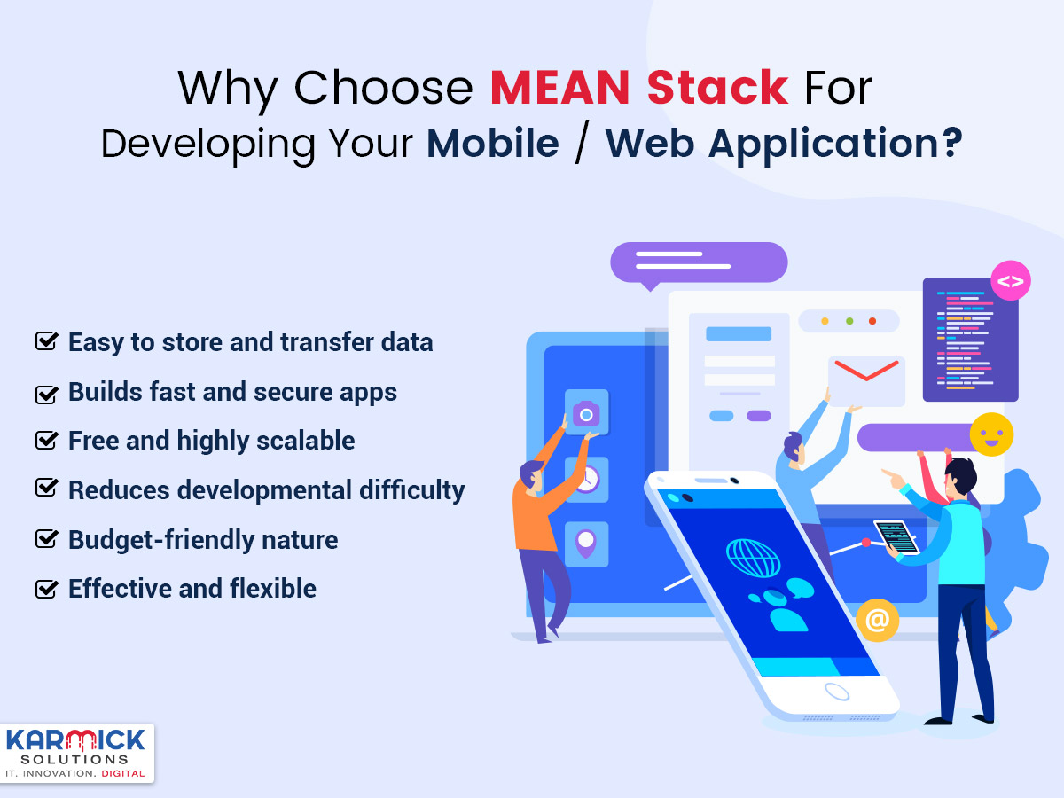
Introduction to mean stack
Why choose Mean Stack?
Scalable and Flexible
Excellent Speed
One Stack, one language
Free of Cost
User-Friendly
Avoids Rewriting
Image Source: https://karmicksolutions.com/blog/why-choose-mean-stack-for-developing-your-mobile-web-application/
Notes:
Left (White Color space):
Title - Parent Topic
Subtitle - Subtopic
Body Text - Description in bullets
Right (Grey Color Space):
Body Text - Relevant image (with source)/code snippet
Reference:
https://karmicksolutions.com/blog/why-choose-mean-stack-for-developing-your-mobile-web-application/

Slide 10
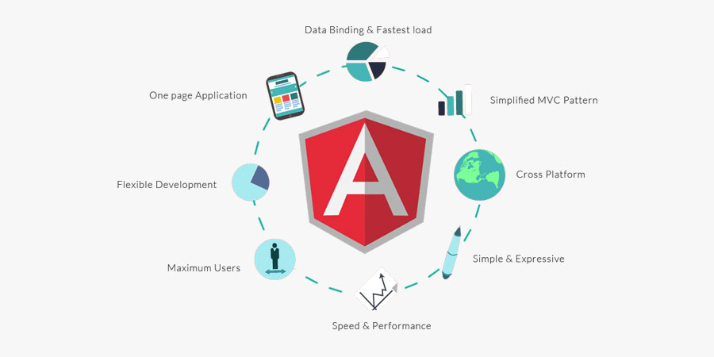
Introduction to AngularJS and UI benefits in Angular JS
Introduction to Angular JS
AngularJS is an open-source web application framework.
It was originally developed in 2009 by Misko Hevery and Adam Abrons. It is now maintained by Google.
Image Source: https://www.etatvasoft.com/blog/angular-js-the-superheroic-javascript-framework/
Notes:
This slide talks about the case if we have to divide a subtopic further.
Left (White Color space):
Title - Parent Topic
Subtitle - Subtopic 2
Body Text - Description in bullets
Right (Grey Color Space):
Body Text - Relevant image (with source)/code snippet
AngularJS is an open-source Model-View-Controller framework (MVC) that is similar to the JavaScript framework. AngularJS is probably one of the most popular modern-day web frameworks available today. This framework is used for developing mostly Single Page applications. This framework has been developed by a group of developers from Google itself.
It can be added to an HTML page with a <script> tag. It enables us to create single-page applications that only require HTML, CSS, and JavaScript on the client side.
AngularJS extends HTML attributes with Directives and Data binding to HTML with Expressions.
Reference:
https://www.etatvasoft.com/blog/angular-js-the-superheroic-javascript-framework/

Slide 11
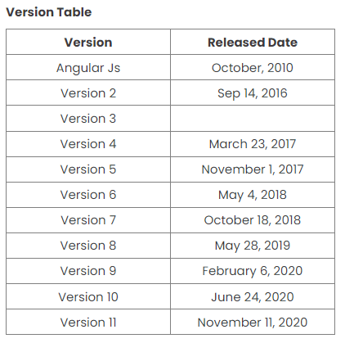
Introduction to AngularJS and UI benefits in Angular JS
Angular Version History
Angular is a well known powerful web application framework in use today.
To provide better stability and highly optimized web application, Angular has released multiple versions from time to time.
Image Source: https://www.c-sharpcorner.com/article/angular-version-change-frequency/
Notes:
Left (White Color space):
Title - Parent Topic
Subtitle - Subtopic
Body Text - Description in bullets
Right (Grey Color Space):
Body Text - Relevant image (with source)/code snippet
Angular JS 1.x - The first release was in October 2010.
Features
It is JavaScript dependent open-source front-end web application.
It is written in JavaScript.
Angular 2 - Released in September 2016.
Features
It was completely different from Angular JS. It was written in TypeScript.
It is mobile-oriented.
Angular 3 - This version was not released due to mismatched libraries.
Angular 4 - It was released in March 2014.
Features
Fast Compilation
Better Bug fixes Alert
Code size was decreased to a large extent.
Angular 5 - It was released in November 2017.
Features
It improves compiler working
Angular forms
Internationalized
Angular 6 - It was released in May 2018.
Features
Angular Elements
CLI workspace
Library Support
Tree Shakable Providers
New angular CLI commands added
Schematics
Angular 7 - It was released in Oct 2018.
Features
CLI Prompts
Bundle budgets
Angular Material and CDK
Angular 8 - It was released in May 2019.
Features
Web worker support
Builders APIs in CLI
Workspace APIs
Dynamic Imports for Route configuration
Angular 9 - It was released in Feb 2020.
Features
Ivy Compiler
Component Harnesses
TypeScript 3.7 Support
Angular 10 - It was released in June 2020.
Features
TypeScript 3.9
Optional Stricter Settings
Date Range Component
New Default Browser
Angular 11
It was released in November 2020.
Reference:
https://www.c-sharpcorner.com/article/angular-version-change-frequency/

Slide 12
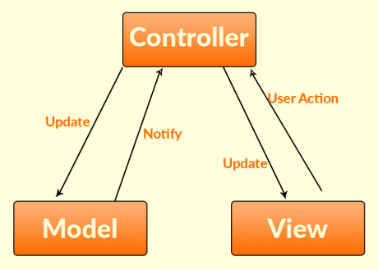
Introduction to AngularJS and UI benefits in Angular JS
AngularJS Architecture
MVC stands for Model View Controller.
It is a software design pattern for developing web applications.
Image Source: https://intellipaat.com/blog/tutorial/angularjs-tutorial/mvc-angularjs/
Notes:
Left (White Color space):
Title - Parent Topic
Subtitle - Subtopic
Body Text - Description in bullets
Right (Grey Color Space):
Body Text - Relevant image (with source)/code snippet
Model – A model in AngularJS is a primitive data type such as number, string, boolean, object, etc. It is a simple JavaScript object without any getter and setter methods.
View – In AngularJS Document Object Model (DOM) is the what users see. In order to display the data from controller, Angular expressions can be added to the view which will coordinate model and view about any modification.
Controller – Controller is a collection of JavaScript classes where application logic is defined. Model resides inside this controller.
Reference:
https://intellipaat.com/blog/tutorial/angularjs-tutorial/mvc-angularjs/

Slide 13
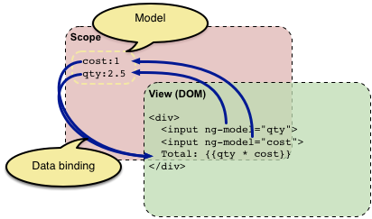
Introduction to AngularJS and UI benefits in Angular JS
Concepts of AngularJS
Modules
Directives
Expressions
Controller
Scope
Data Binding
Image Source: https://docs.angularjs.org/guide/concepts
Notes:
Left (White Color space):
Title - Parent Topic
Subtitle - Subtopic
Body Text - Description in bullets
Right (Grey Color Space):
Body Text - Relevant image (with source)/code snippet
Concept of AngularJS
Modules - A module can be defined as a container that consists of various application parts. The module is a set of functions defined in a JavaScript file. Module divides an application into small and reusable components.
Directives -Directives indicate the compiler to associate a behavior to the DOM element or modify it. Angular JS contains several directives such as ng-app, ng-controller, ng-view, ng-if, etc.
Expressions -Angular JS expressions are expressed with {{ }} which indicate a data binding in HTML. These expressions can be added into the HTML templates. Expressions do not support control flow statements while support the filters.
Controller- It is a JavaScript object constructor function that controls the AngularJS applications.
Scope- It is a JavaScript object that acts as a bridge between the Controller and the View. It is the source of data in AngularJS. Each data manipulation and assignment takes place with the help of the Scope object.
Data Binding- It coordinates the model and views any changes in either of these two.
Reference:
https://docs.angularjs.org/guide/concepts

Slide 14
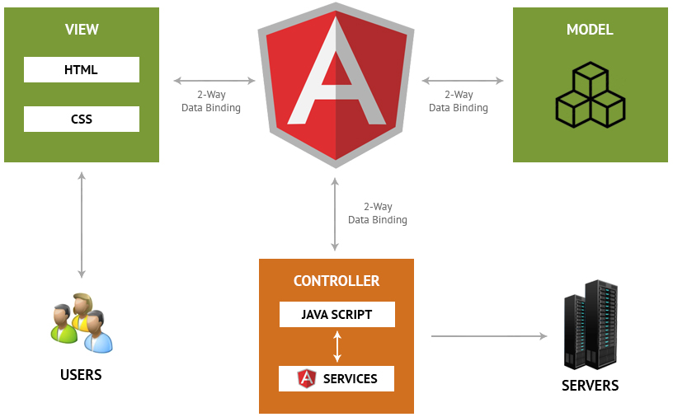
Introduction to AngularJS and UI benefits in Angular JS
Concepts of AngularJS
Validations
Filters
Services
Routing
Dependency Injection
Testing
Image Source: https://www.matridtech.net/5-key-features-of-angularjs-that-make-it-the-best-for-web-development
Notes:
Continuing from the last slide:
Left (White Color space):
Title - Parent Topic
Subtitle - Subtopic
Body Text - Description in bullets
Right (Grey Color Space):
Body Text - Relevant image (with source)/code snippet
Validations- Validations take place with the help of AngularJS forms and controls.
Filters -These let you display the formatting of data on DOM in Angular and extend the behavior of directives and binding expressions. Filters format the values or apply specific.
Services -These are singletons that are used by directives, controllers, or other services.
Routing -The service $routeProvider handles the operations of Routing. It divides the map into various views . It helps split the Single Page Applications into different views.
Dependency Injection-It is a design pattern used to handle the dependencies of various components of a software. It lets you develop loosely-structured architectures.
Testing -The codes developed by Dependency Injections are tested. Some of the popular testing frameworks like Jasmine and Karma are two widely-used technologies.
Reference:
https://www.matridtech.net/5-key-features-of-angularjs-that-make-it-the-best-for-web-development

Slide 15
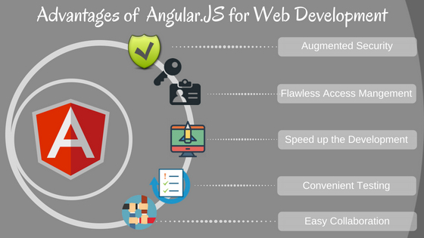
Introduction to AngularJS and UI benefits in Angular JS
Advantages of AngularJS
Easy to Learn
It has a Two-Way Binding Feature
Supports SPA features
Has a Declarative UI
Supported by Google
Allows for Optimal Web Application Management
It is a Powerful Framework
Real-Time Testing
Image Source: https://www.v2web.in/blog/5-advantages-of-angular-js-for-web-development/
Notes:
Left (White Color space):
Title - Parent Topic
Subtitle - Subtopic
Body Text - Description in bullets
Right (Grey Color Space):
Body Text - Relevant image (with source)/code snippet
Advantages
It provides the capability to create Single Page Application in a very clean and maintainable way.
It provides data binding capability to HTML. Thus, it gives user a rich and responsive experience.
AngularJS code is unit testable.
AngularJS uses dependency injection and make use of separation of concerns.
AngularJS provides reusable components.
With AngularJS, the developers can achieve more functionality with short code.
In AngularJS, views are pure html pages, and controllers written in JavaScript do the business processing.
Reference:
https://www.v2web.in/blog/5-advantages-of-angular-js-for-web-development/

Slide 16
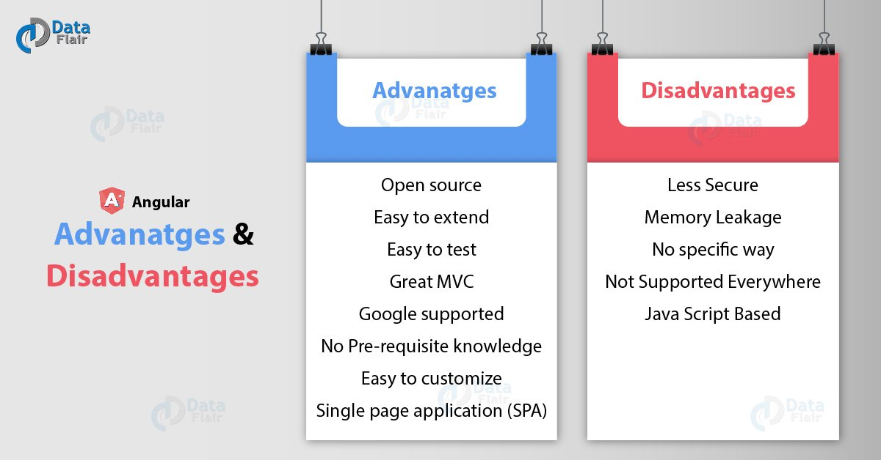
Introduction to AngularJS and UI benefits in Angular JS
Disadvantages of AngularJS
Not Secure
Not degradable
Complex at times
Image Source: https://data-flair.training/blogs/wp-content/uploads/sites/2/2019/01/Angular-Advanatges-Disadvanatges-01.jpg
Notes:
Left (White Color space):
Title - Parent Topic
Subtitle - Subtopic
Body Text - Description in bullets
Right (Grey Color Space):
Body Text - Relevant image (with source)/code snippet
Diadvantages
Not Secure − Being JavaScript only framework, application written in AngularJS are not safe. Server side authentication and authorization is must to keep an application secure.
Not degradable − If the user of your application disables JavaScript, then nothing would be visible, except the basic page.
Complex at times – At times AngularJS becomes complex to handles as there are multiple ways to do the same thing. This creates confusion and requires considerable efforts.
Reference:
https://data-flair.training/blogs/wp-content/uploads/sites/2/2019/01/Angular-Advanatges-Disadvanatges-01.jpg

Slide 17
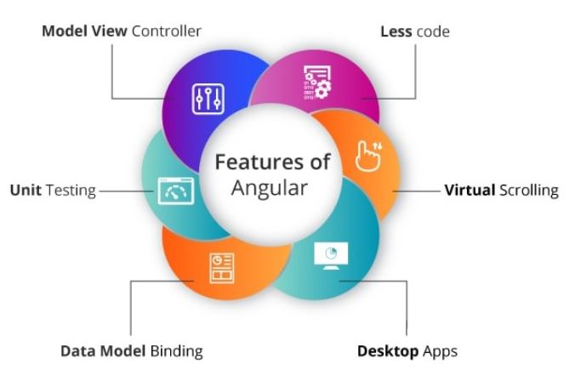
Introduction to AngularJS and UI benefits in Angular JS
General features
Data Binding.
Architecture.
Directives.
Not Browser Specific.
Codeless.
Speed and Performance.
Dependency Injection.
Deep Linking.
Image Source: https://www.educative.io/edpresso/what-is-mean-stack
Notes:
Left (White Color space):
Title - Parent Topic
Subtitle - Subtopic
Body Text - Description in bullets
Right (Grey Color Space):
Body Text - Relevant image (with source)/code snippet
Features
We can create rich internet application by using Angular JS.
Angular js Allow us to write the client-side code using javascript in an MVC way.
AngularJs provides cross-browser compliant and it automatically handles JavaScript code suitable for each browser.
The AngularJs is Completely free and opensource it is used by thousands of developers all around the world.
Angularjs is used to build high-performance, large scale, and easy-to-maintain web applications.
Reference:
https://www.educative.io/edpresso/what-is-mean-stack

Slide 18
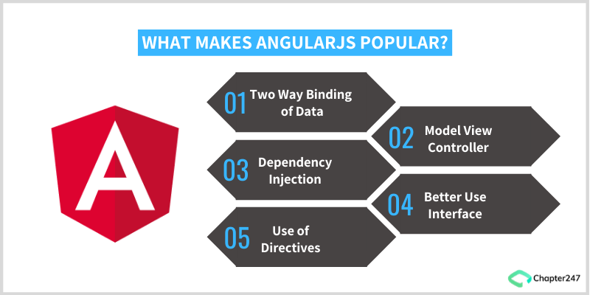
Introduction to AngularJS and UI benefits in Angular JS
UI benefits in Angular JS
Provides immense support to XAML
Provides a simplistic approach to data binding
Reduces application side-effects by allowing developers to express Declarative UI
Simplifies testing
Gives Design development workflow a
Makes Single Page Applications easy
Image Source: https://www.chapter247.com/blog/top-features-and-benefits-of-angularjs/
Notes:
This slide talks about the case if we have to divide a subtopic further.
Left (White Color space):
Title - Parent Topic
Subtitle - Subtopic
Body Text - Description in bullets
Right (Grey Color Space):
Body Text - Relevant image (with source)/code snippet
Provides immense support to XAML Development
XAML is an XML based markup language which is used to instantiate object graphs and set values. It allows you to define various types of objects with properties. It makes it easy to layout complex, ever changing UIs. It also supports for data-binding which allows a symbiosis between the presentation layer and your data without creating hard dependencies between its components. It also enables a developer to conduct any number of testing scenarios. AngularJS translates very well with XAML principles. It also allows a parallel workflow between different aspects that include the markup for the UI itself as well as the underlying logic that fetches and processes data.
Provides a simplistic approach to data binding
Data binding is very easy in the Angular world. The framework eliminates the need to derive from an existing object or place all your properties and dependencies cards on the table. AngularJS uses dirty tracking to enable this. Though several existing frameworks have evolved, the process of mapping everything explicitly to an interim object to data-bind to Angular is significantly easier and faster.
Reduces application side-effects by allowing developers to express declarative UI
Declarative UI has several advantages. A structured UI enables easy understanding and manipulation of the application. Using jQuery forces the developer to know a lot about the document structure which often creates two issues: first, a fairly unstable code working as “glue” that tightly grips the changes in the UI, and second, there is an uncertainty because it is hard to judge by studying the markup just how the UI would function. Placing markup directly in HTML, one can separate the presentation logic from imperative logic and keep it in one place. Understanding of the extended markup provided by Angular i.e. code snippets makes the whereabouts of the data amply clear. The addition, tools like directives and filters not only make the UI intent even more clear but also give clarity on how the information is being shaped.
Simplifies testing
AngularJS product engineering adeptly embraces Test-Driven Development, Behavior-Driven Development, or any of the driven-development methodologies of building an application. It helps in saving time and change the way an application is structured. Angular can help to test everything UI behavior to business logic with its ability to mock dependencies.
Gives Design development workflow a new meaning
Even though HTML and CSS support design, but AngularJS allows a developer to add a markup without completely breaking an application. It often depends on a certain id or structure to locate an element and perform tasks. Developers can rearrange portions of code by moving the elements around and the corresponding code that does the binding and filtering job moves with it.
Makes Single Page Applications easy
The growing popularity of Single Page Applications among AngularJS development companies is not unfounded as they cater to a very specific need. With more and more functionality finding its way to the web, developers are progressively realizing the potential of the browser as a distributed computing node. SPA boasts of more responsive design and can provide an experience of a native app on the web. AngularJS is an apt infrastructure that supports routing, templates, and even journaling making it viable accomplice of SPA.
Here are some additional advantages to leverage for awesome front-end product engineering:
Improved Plug & Play Features – AngularJS makes it easy to add components from an existing application to a new application. It only needs a copy-paste command to make your existing assets available in a new environment.
Quicker Development Turnaround Time – AngularJS supported by the MVC architecture ensures faster development, testing, and maintenance. The quicker turnaround time allows developers to enhance their productivity.
Superior Dependency Handling – One of the biggest USPs of AngularJS is its “dependency injection”. Testing and Single Page Application have been enormously simplified because of the dependency injection feature.
Makes Parallel Development Possible – Apart from faster development, AngularJS in collaboration with MVC architecture allows the developer to perform parallel application development which makes it stand-out amongst the competition.
Gives More Control to the Developers – AngularJS directives give superior control to developers, who get a free hand to experiment with HTML and attributes. The directives allow them more independence to help them create more responsive platforms.
State Management Made Easy – AngularJS helps you manage any application state easily whether it is illusioned or disillusioned. It is highly conducive when it comes to managing properties, permissions, and other major concerns across the application.
Reference:
https://www.chapter247.com/blog/top-features-and-benefits-of-angularjs/

Slide 19
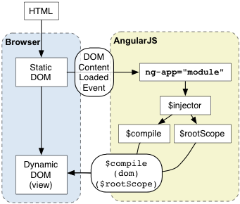
Usage of Angular JS with HTML
AngularJS with HTML
AngularJS is a JavaScript framework. It can be added to an HTML page with a <script> tag. AngularJS extends HTML attributes with Directives, and binds data to HTML with Expressions.
Image Source: https://docs.angularjs.org/guide/bootstrap
Notes:
This slide talks about the case if we have to divide a subtopic further.
Title Box - Parent Topic
Subtitle box - Sub Topic 3
Body Text - Subtopic divisions (Subtopics of subtopics)
Reference:
https://www.thirdrocktechkno.com/blog/what-is-mean-stack-mean-stack-components-and-benefits/

Slide 20
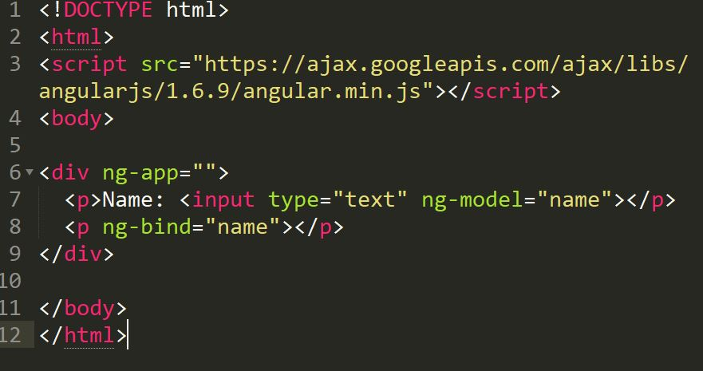
Usage of Angular JS with HTML
AngularJS with HTML
AngularJS is a JavaScript framework. It can be added to an HTML page with a <script> tag. AngularJS extends HTML attributes with Directives, and binds data to HTML with Expressions.
Notes:
Continuing from the last slide:
Title Box - Parent Topic
Subtitle box - Sub Topic
Body Text - Subtopic divisions (Subtopics of subtopics)
AngularJS extends HTML with ng-directives.
The ng-app directive defines an AngularJS application.
The ng-model directive binds the value of HTML controls (input, select, textarea) to application data.
The ng-bind directive binds application data to the HTML view.
Reference:

Slide 21
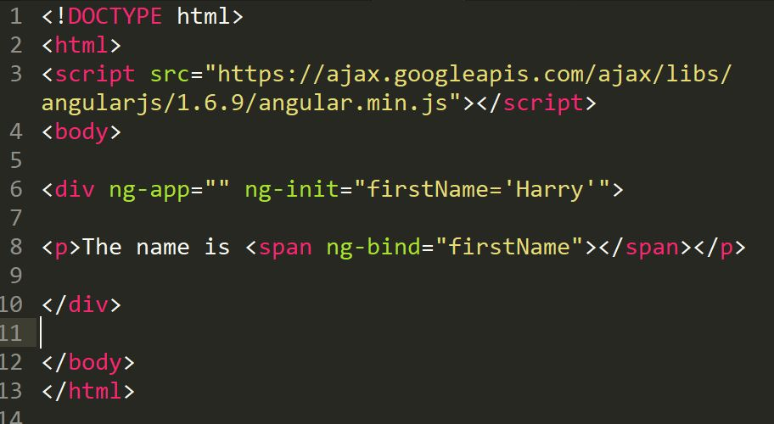
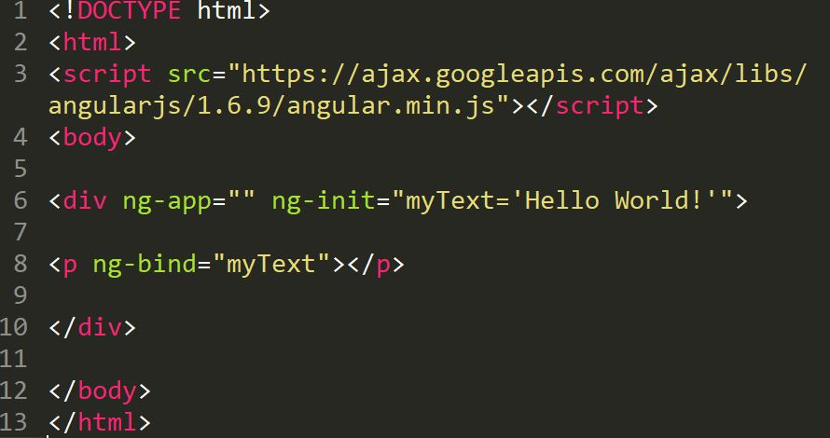
Usage of Angular JS with HTML
AngularJS Directives & Expressions
The ng-init directive initializes AngularJS application variables.
AngularJS expressions are written inside double braces: {{ expression }}.
Notes:
Title Box - Parent Topic
Subtitle box - Sub Topic
Body Text - Subtopic divisions (Subtopics of subtopics)
As you have already seen, AngularJS directives are HTML attributes with an ng prefix.
The ng-init directive initializes AngularJS application variables
AngularJS expressions bind AngularJS data to HTML the same way as the ng-bind directive.
The ng-bind directive tells AngularJS to replace the content of an HTML element with the value of a given variable, or expression.
If the value of the given variable, or expression, changes, the content of the specified HTML element will be changed as well.
Reference:

Slide 22
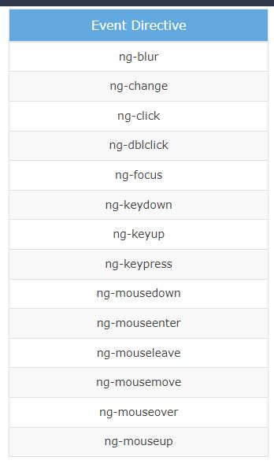
Event Handling in Angular JS
Event Handling
AngularJS includes certain directives which can be used to provide custom behavior on various DOM events, such as click, dblclick, mouseenter etc.
Image Source: https://www.guru99.com/images/AngularJS/010416_0549_AngularJSIn1.png
Notes:
This slide talks about the case if we have to divide a subtopic further.
Title Box - Parent Topic
Subtitle box - Sub Topic 4
Body Text - Subtopic divisions (Subtopics of subtopics)
ng-mousemove: Movement of mouse leads to the execution of event.
ng-mouseup: Movement of mouse upwards leads to the execution of event.
ng-mousedown: Movement of mouse downwards leads to the execution of event.
ng-mouseenter: Click of the mouse button leads to the execution of event.
ng-mouseover: Hovering of the mouse leads to the execution of event.
ng-cut: Cut operation leads to the execution of the event.
ng-copy: Copy operation leads to the execution of the event.
ng-keypress: Press of key leads to the execution of the event.
ng-keyup: Press of upward arrow key leads to the execution of the event.
ng-keydown: Press of downward arrow key leads to the execution of the event.
ng-click: Single click leads to the execution of the event.
ng-dblclick: Double click leads to the execution of the event.
Reference:
https://www.guru99.com/images/AngularJS/010416_0549_AngularJSIn1.png

Slide 23
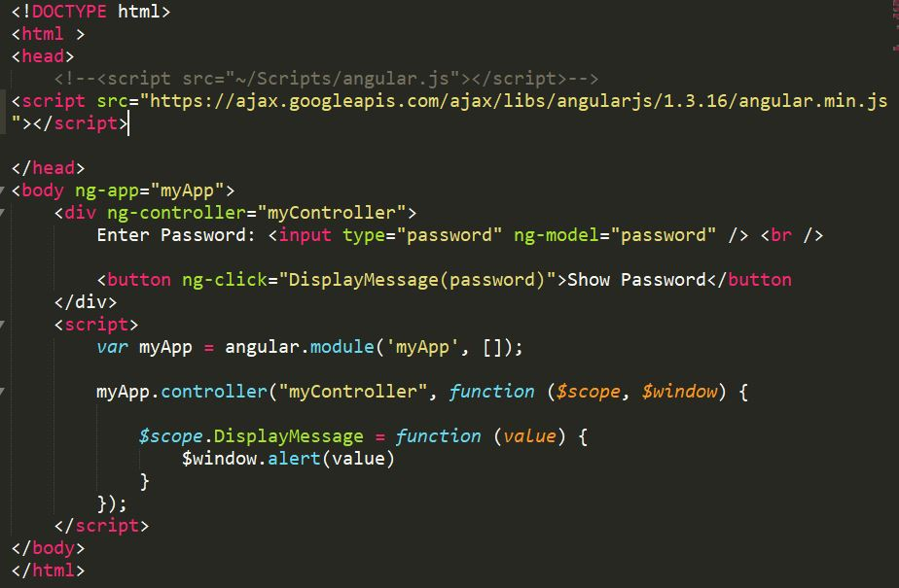
Event Handling in Angular JS
AngularJS Events
Mouse Events
Click Events
Keyboard Events
Notes:
Title Box - Parent Topic
Subtitle box - Sub Topic
Body Text - Subtopic divisions (Subtopics of subtopics)
The ng-click directive is used to provide event handler for click event.
Reference:

Slide 24
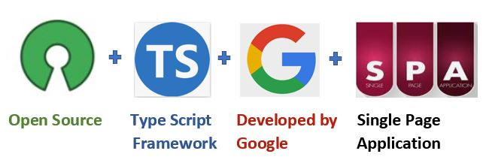
Introduction Angular & difference b/w angular-1 and angular-5
Introduction Angular
Angular is a platform and framework for building single-page client applications using HTML and TypeScript
Image Source: https://www.c-sharpcorner.com/article/what-is-angular-and-features-release-in-angular-13/
Notes:
This slide talks about the case if we have to divide a subtopic further.
Title Box - Parent Topic
Subtitle box - Sub Topic 5
Body Text - Subtopic divisions (Subtopics of subtopics)
Angular is written in TypeScript. It implements core and optional functionality as a set of TypeScript libraries that you import into your applications.
Reference:
https://www.c-sharpcorner.com/article/what-is-angular-and-features-release-in-angular-13/

Slide 25
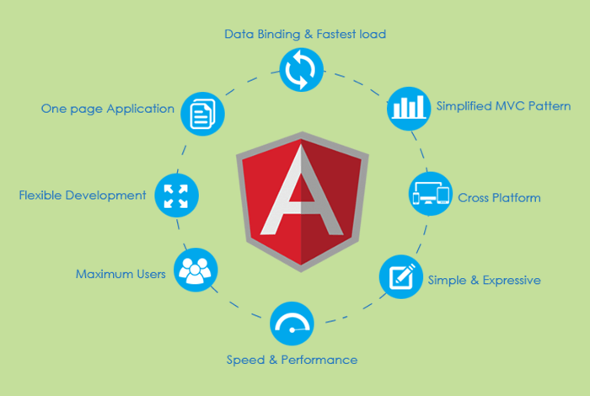
Introduction Angular & difference b/w angular-1 and angular-5
Top 12 Angular Features
Cross-platform
Efficient MVC architecture
Sectional structure
The eminence of Angular CLI
Data binding
Set of Directives
Image Source: https://www.mobileappdaily.com/angular-framework-best-use-casess
Notes:
.
Title Box - Parent Topic
Subtitle box - Sub Topic
Body Text - Subtopic divisions (Subtopics of subtopics)
Cross-platform
It is imperative to have this factor first on the Angular features list because Angular plays a prominent role in developing Progressive Web Applications (PWA). With PWA by your side, audiences can enjoy an app-like experience using contemporary web capabilities. Most importantly, with this feature, you can deploy a local or a progressive app.
Efficient MVC architecture
The Model-View-Controller (MVC) architecture is among the leading Angular 8 features. MVC enhances the worth of the framework for client-side application development and takes care of other features like data binding and scopes. As compared to other frameworks, MVC blends in all the necessary elements of the application to waive off extra coding.
Sectional structure
The best part about the Angular framework is it helps in organizing code into different modules as and when you build them. Due to this feature, there is a division of overall functionality into reusable code. Furthermore, this helps in the division of tasks among the Angular developers and permits web applications to accomplish lazy loading.
The eminence of Angular CLI
Angular’s Command Line Interface (CLI) is a boon for web development. CLI helps in automating certain processes with simple commands. You may add or remove defined functionalities with a combination of these simple commands. In addition, it enables running units’ tests and end-to-end tests swiftly. All these AngularJS features enhance the code quality considerably.
Data binding
With data binding by your side, a user can easily manipulate web page elements through a web browser. It utilizes dynamic HTML and waives off intricate scripting or programming. Data binding plays a vital role when coming up with web pages equipped with interactive components, like games, tutorials, etc. Also, when a web page has way too much data, it enables a better display.
Besides, a model is a place where you make edits in the application. Those changes are reflected in UI elements. When the model changes, the developer supposedly has to make manual edits in the DOM elements, and then the attributes start reflecting. It is a cumbersome task, but Angular eliminates it with two-way data-binding. This process helps in synchronizing the DOM and the model, and vice versa.
Set of Directives
AngularJS expands the functionality of HTML with a set of inbuilt attributes, also known as directives. The imperative functionality of these directives is to boost the competence of HTML. With this, it becomes immensely appropriate for dynamic client-side applications. The best part is these directives can be self-initiated using AngularJS.
Reference:
https://www.mobileappdaily.com/angular-framework-best-use-casess

Slide 26
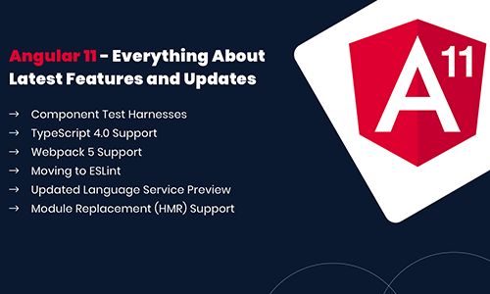
Introduction Angular & difference b/w angular-1 and angular-5
Top 12 Angular Features
Prominence of TypeScript
Declarative UI
Extensive documentation and support
The prowess of Ivy Renderer
Test-friendliness
Timely upgradations
Image Source: https://www.angularminds.com/blog/article/top-features-of-angular-11.html
Notes:
Continuing from the last slide:
Title Box - Parent Topic
Subtitle box - Sub Topic
Body Text - Subtopic divisions (Subtopics of subtopics)
Prominence of TypeScript
TypeScript is the superscript of JavaScript. The main advantage of using TypeScript is you can detect and correct errors in the code while writing. It also supports AngularJS security features like primitive and interface. Interestingly, Angular is written using TypeScript and boasts all these features.
Declarative UI
One of the AngularJS key features is declarative UI. In Angular, you can skip using JavaScript to outline the UI of your web application and instead use HTML as it is less complicated than JavaScript. HTML is a blessing for Angular applications as it imports declarative and intuitive properties of the UI components. With properties like these, you don’t have to initiate manual program flows. Instead, you can simply describe the page layout and the path of the data. Further, Angular declarative UI takes care of the components as per the layout. With this, ample time and effort are saved in front-end development.
Extensive documentation and support
Google supports Angular because of the stability of the framework. Most importantly, Google has enriched the Angular community with documentation and tools to build functionalities and resolve issues. Due to these reasons, a developer is never helpless in the Angular community. The answers are readily available either in the documents or in the online forums.
The prowess of Ivy Renderer
A renderer helps in translating a code written in TypeScript and HTML into standard JavaScript instructions. With this, it helps the browser to interpret. Renderer makes your components and templates understandable for the browser to display them aptly. Furthermore, with its tree shaking technique, Ivy Renderer removes unused code, making the web application smaller and boosting its loading speed. All in all, this feature reduces the size of the Angular framework and makes the bundle a bit smaller.
Test-friendliness
JavaScript is an interpreted language, which makes it imperative for developers to test the code capability. But while using AngularJS, developers are unhindered by this requirement. The framework has features like Dependency Injection (DI) that supports testing. DI simplifies the entire process where the testers must insert the test data in the controller and parallelly check the output. It’s that simple!
Timely upgradations
If you don’t upgrade your framework from time to time, you may lag in this race of the digital world. New settings pour in, and if they are absent, your application will be tagged as outdated. To eliminate this problem, Angular improves its Component Development Kit (CDK) on a timely basis. It not only enhances but also takes care of the angular version upgrades.
Reference:
https://www.angularminds.com/blog/article/top-features-of-angular-11.html

Slide 27
Introduction Angular & difference b/w angular-1 to angular-5
Angular 1 | Angular 5
Released by Google in the year 2010. | Released by Google in the year 2017.
JavaScript-based framework for creating SPA. | Angular 5 comes with build optimizer which is a part of the platform’s command like a tool.
Still supported but no longer will be developed.
The architecture of AngularJS is based on MVC.
AngularJS was not developed with a mobile base in mind.
AngularJS code can write by using only ES5, ES6, and Dart. | Compiler Improvements
Based on controllers whose scope is now over. | New Router Lifecycle Event
Factory, service, provider, value and constant are used for services | Optimization with HTTP Client Feature Internationalized Date & Currency
Run on only client-side
ng-app and angular bootstrap function are used to initialize
Difference b/wAngular-1 to Angular-5
Prominence of TypeScript
Declarative UI
Extensive documentation and support
The prowess of Ivy Renderer
Test-friendliness
Timely upgradations
Notes:
Title Box - Parent Topic
Subtitle box - Sub Topic
Body Text - Subtopic divisions (Subtopics of subtopics)
Angular JS
AngularJS is the official name, but some developers also refer to this as Angular 1. It is a front-end and open-source web application framework based on JavaScript. It uses HTML as a template in this framework. In AngularJS, the data and expressions are merged to create an expressive environment for developing web applications quickly. It simplifies both the testing and development of applications by providing a framework for client-side model–view–controller (MVC) and Model–View–ViewModel (MVVM) architectures, along with components commonly used in rich Internet applications.
It uses the controller approach where the view communicates using a $scope.
Angular 5
Angular 5 is more advanced and has more enhanced features than Angular 4. The best feature of Angular 5 is that it aids developers in removing unnecessary codes from their applications.
Other improved features are a code-sharing feature, less time for assembling dynamic web applications, and so on. Moreover, it has DOM support, and its compiler helps with incremental compilation.
Reference:

Slide 28
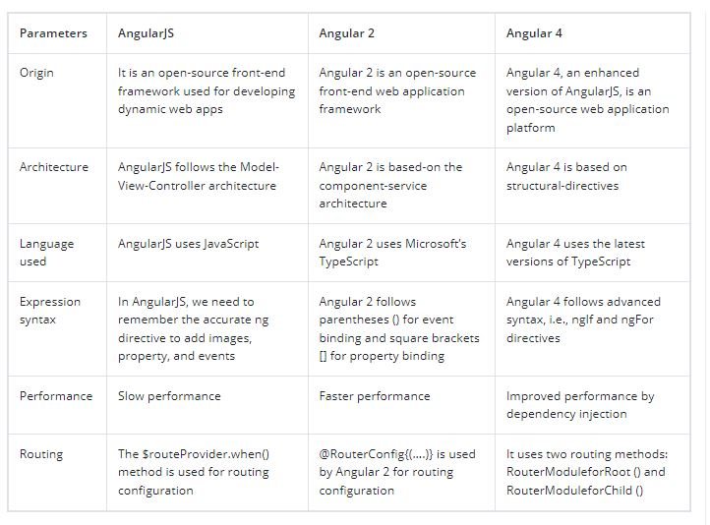
Introduction Angular & difference b/w angular-1 to angular-5
It is a JavaScript Framework
It provides HTML support.
Allows event handling and data binding
Animation and form package
Image Source: https://www.angularminds.com/blog/article/top-features-of-angular-11.html​
Notes:
Title Box - Parent Topic
Subtitle box - Sub Topic
Body Text - Subtopic divisions (Subtopics of subtopics)
Angular JS
AngularJS is the official name, but some developers also refer to this as Angular 1. It is a front-end and open-source web application framework based on JavaScript. It uses HTML as a template in this framework. In AngularJS, the data and expressions are merged to create an expressive environment for developing web applications quickly. It simplifies both the testing and development of applications by providing a framework for client-side model–view–controller (MVC) and Model–View–ViewModel (MVVM) architectures, along with components commonly used in rich Internet applications.
It uses the controller approach where the view communicates using a $scope.
Angular 5
Angular 5 is more advanced and has more enhanced features than Angular 4. The best feature of Angular 5 is that it aids developers in removing unnecessary codes from their applications.
Other improved features are a code-sharing feature, less time for assembling dynamic web applications, and so on. Moreover, it has DOM support, and its compiler helps with incremental compilation.
Reference:
https://www.angularminds.com/blog/article/top-features-of-angular-11.html

